Slide 1
Geasture Droid
Christoph Fuchs
Roman Hochstöger

Slide 2
Content
Introduction & Motivation
Used Hardware
Software
Server program
Evaluation of measured data
Problems
Conclusions

Slide 3
Introduction & Motivation
Procedure of a movement (Smartphone and/ or Wii-Remote)
Restricted movement
Nearly similar movements
Transmission of data to the server program
Analysis of movement data

Slide 4
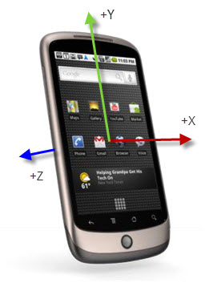
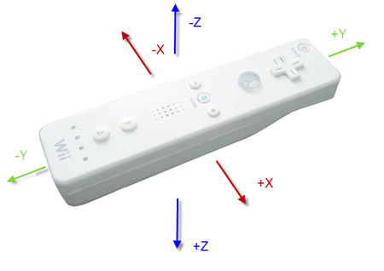
Used Hardware
Smartphone
HTC N1 & HTC DESIRE
Wii-Remote

Slide 5
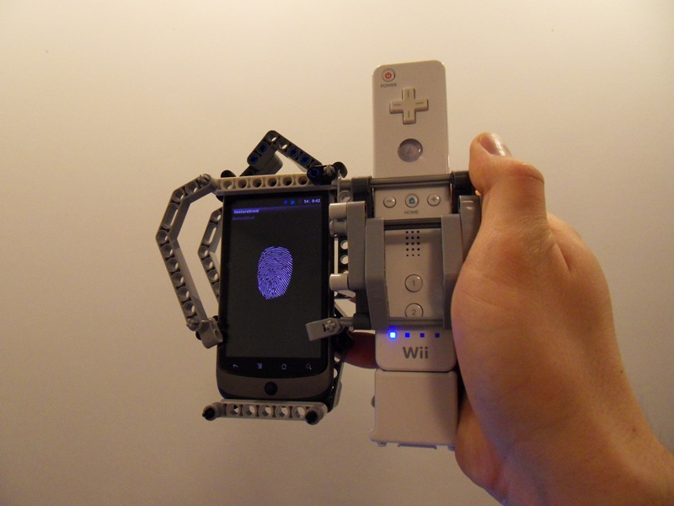
Used Hardware
Mounting Device

Slide 6
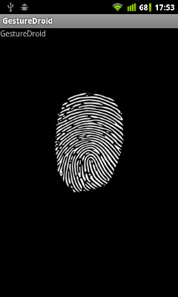
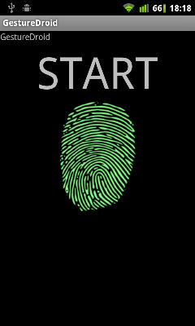
Software
GestureDroid (Android-App):
Read the sensors
Transmission of data to the server programm via TCP

Slide 7
Software
Server program (Java):
Connection via
TCP (Smartphone)
Bluetooth (Wii-Remote)
Visualization of the position
Check of data connection

Slide 8
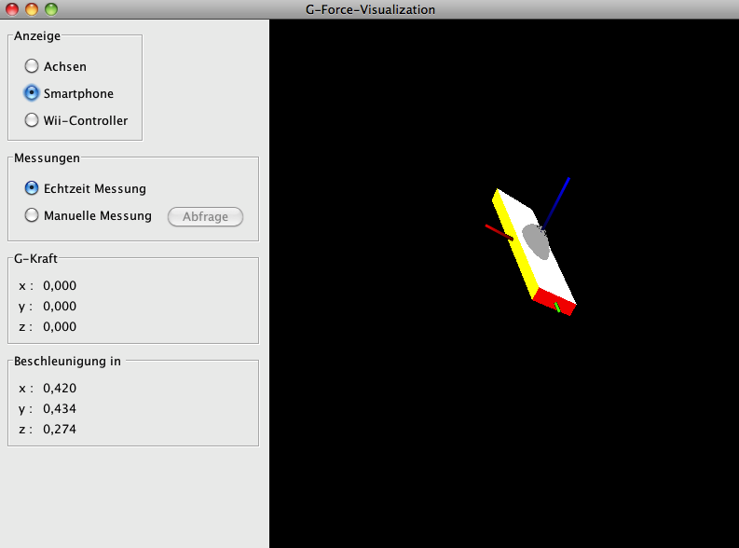
Software
Server program:

Slide 9
Software
Visualization of movement data (MATLAB):
Visualization of movement data
Comparison of movement data:
Different performances of one movement
Different kinds of movements
Different kind of hardware

Slide 10
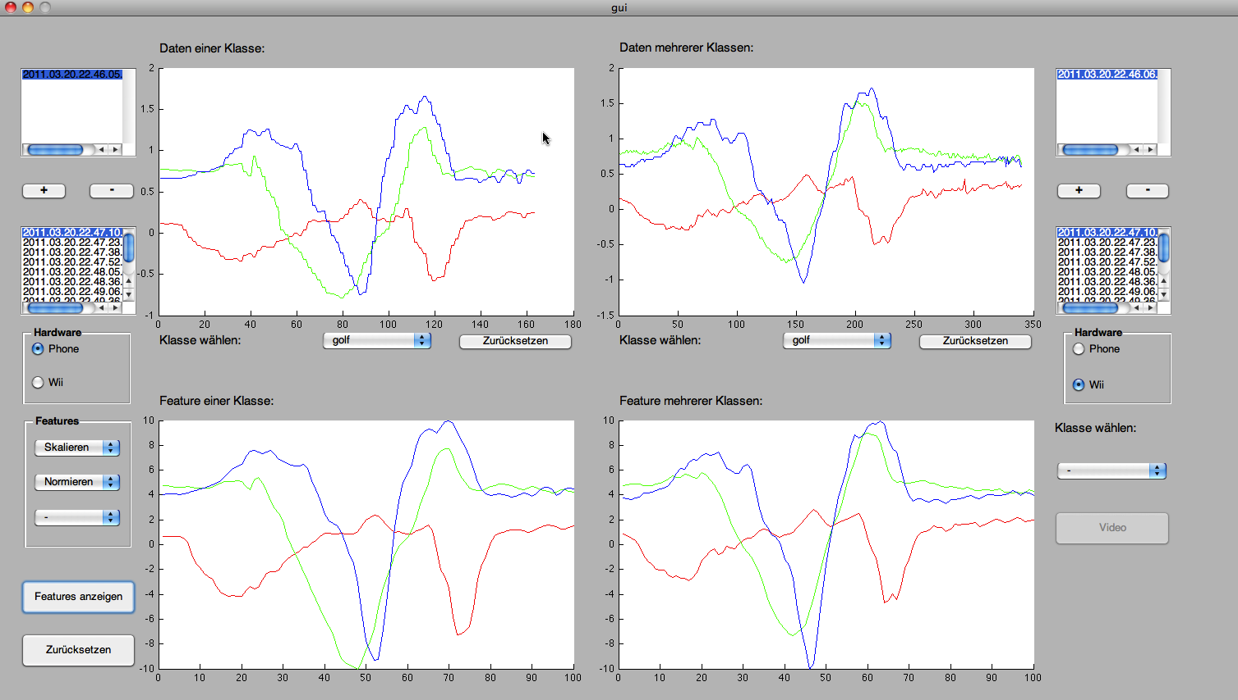
Software
Visualization of movement data:

Slide 11
Problems
Evaluation of the orientation sensor
Orientation is calculated by acceleration
Determination of orientation in space
Data connection between Wii and PC
Driver problems in Windows
Measurement range of smartphones
Movement velocity has not to be over 2g

Slide 12
Conclusions
Orientation of smartphones in space during movement is difficult to determine
Acceleration sensors of Wii-Remote and Smartphones deliver similar messure data

